Slide 1
Dysgu Cymraeg SSiW

Slide 2
Croeso! Welcome!
Welcome to Dysgu Cymraeg SSiW!
You have automatic access to SaySomethinginWelsh (SSiW) as you have registered on a Dysgu Cymraeg course – llongyfarchiadau, congratulations!
The next few pages provide more information about SSiW.
We hope you’ll enjoy every minute of learning and using your Welsh!
Croeso i Dysgu Cymraeg SSiW!
Dych chi’n gallu defnyddio SaySomethinginWelsh (SSiW) achos eich bod chi wedi cofrestru ar gwrs Dysgu Cymraeg – llongyfarchiadau!
Mae'r tudalennau nesaf yn cyflwyno mwy o wybodaeth i chi am SSiW.
Gobeithio byddwch chi'n mwynhau pob munud o ddysgu a defnyddio eich Cymraeg!
Notes:
The programme will include the following elements, we will go through them in more detail

Slide 3
Suitable for all
SSiW is suitable for beginners as well as those who already speak some Welsh.
What kind of resource is it?
It is an online self-study resource. You can work at your own pace and at a time that’s convenient for you. You’ll be able to access SSiW on your phone, tablet, or computer (as long as you have an internet connection!).
Addas i bawb
Mae SSiW yn addas ar gyfer dechreuwyr a phobl sy’n barod yn siarad tipyn o Gymraeg.
Pa fath o adnodd yw hwn?
Mae’n adnodd hunan-astudio ar-lein. Dych chi’n gallu gweithio ar eich cyflymder eich hun ac ar adeg sy'n gyfleus i chi. Byddwch yn gallu cael mynediad i SSiW ar eich ffôn, llechen, neu gyfrifiadur (dim ond gyda chysylltiad rhyngrwyd!).
Notes:
The programme will include the following elements, we will go through them in more detail

Slide 4
How do I find the resource?
You’ll receive a link via e-mail to register. Please do not share your link with anyone else.
Once registered, you’ll be able to access SSiW via the following link: https://automagic.saysomethingin.com/learn
We recommend using Google Chrome as a browser, as some other browsers do not support all the interactive elements of the resource.
Sut dw i'n dod o hyd i'r adnodd?
Byddwch yn derbyn dolen drwy e-bost i gofrestru. Peidiwch â rhannu'ch cysylltiad ag unrhyw un arall.
Ar ôl cofrestru, byddwch yn gallu cael mynediad i SSiW trwy'r ddolen ganlynol: https://automagic.saysomethingin.com/learn
’Dyn ni’n argymell defnyddio Google Chrome fel porwr, achos fod rhai porwyr eraill ddim yn cefnogi holl elfennau rhyngweithiol yr adnodd.
Notes:
The programme will include the following elements, we will go through them in more detail

Slide 5
Accessing for the first time
When you click on the link to access SSiW, you’ll be asked to input your name and email address and choose a password (which can be changed later). Once completed, click on the ‘Sign Up’ button to get started. Please use the email address the invite was sent to.
Mynediad am y tro cyntaf
Pan fyddwch yn clicio ar y ddolen i gael mynediad at SSiW, bydd neges yn gofyn i chi roi eich enw a'ch cyfeiriad e-bost, a dewis cyfrinair (mae’n bosib newid hwn nes ymlaen). Ar ôl cwblhau, cliciwch ar y botwm 'Sign Up' i ddechrau. Defnyddiwch y cyfeiriad e-bost yr anfonwyd y gwahoddiad iddo.
Notes:
The programme will include the following elements, we will go through them in more detail

Slide 6
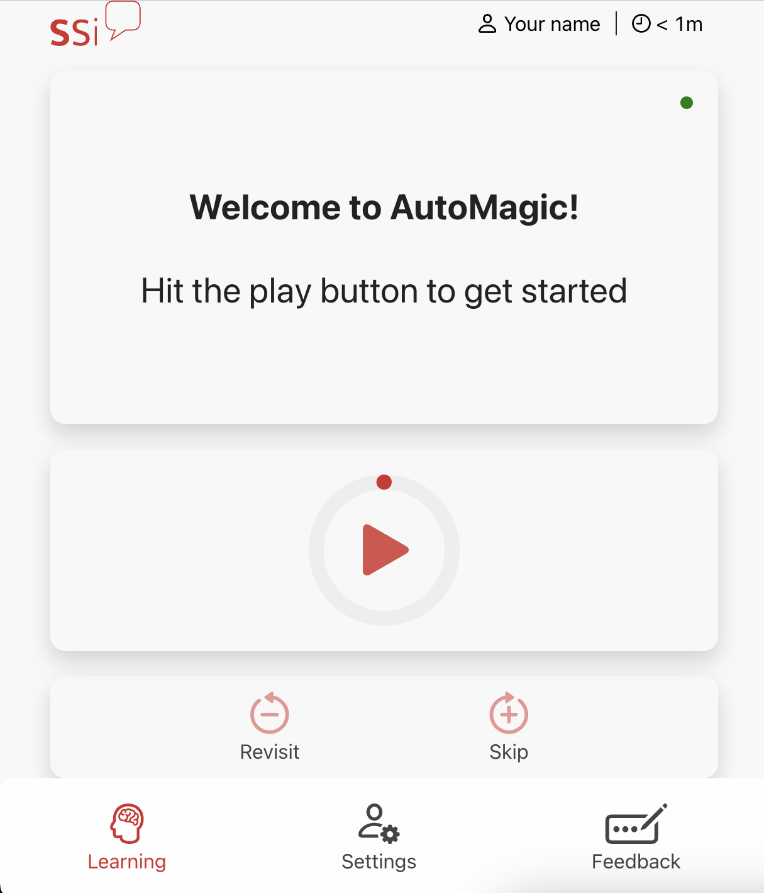
Introduction
Once you’ve signed up, you’ll see and hear an introduction to the learning method. Your name will appear at the top of your screen. If you’d like to change your dialect, name or other settings, just click on the settings symbol on the bottom navigation bar.
Cyflwyniad
Ar ôl cofrestru, byddwch chi’n gweld ac yn clywed cyflwyniad i'r dull dysgu. Bydd eich enw yn ymddangos ar frig eich sgrîn. Os dych chi eisiau newid eich tafodiaith, eich enw neu osodiadau eraill, cliciwch ar y symbol gosodiadau ar y bar ar y gwaelod.
Settings icon
me
Notes:
The programme will include the following elements, we will go through them in more detail

Slide 7
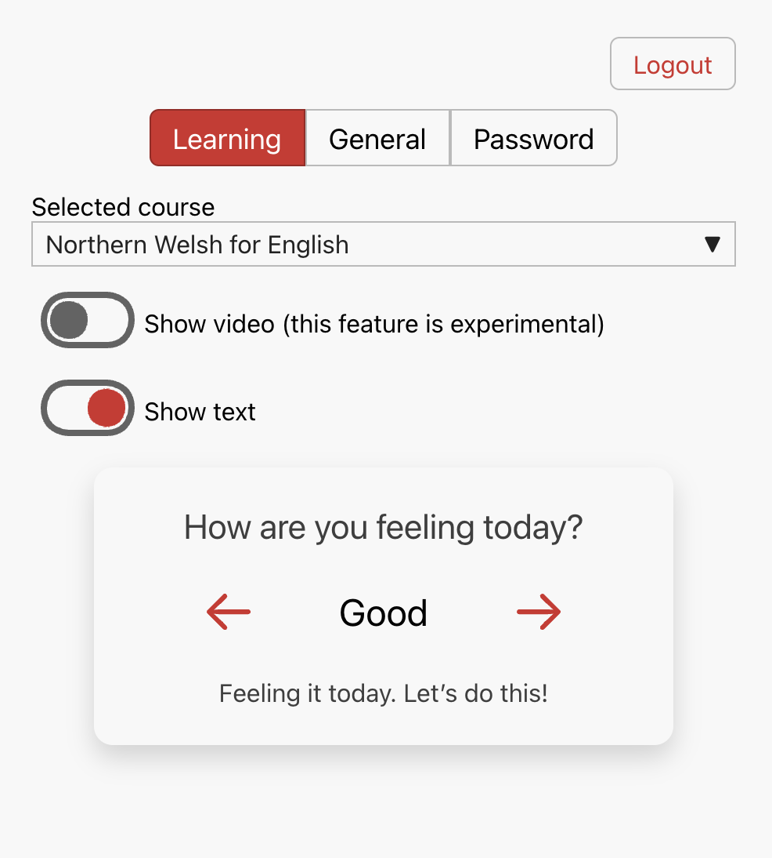
Settings
You can…
Newid gosodiadau /
Switch between setting tabs
Allgofnodi / Logout
Gosodiadau
Dych chi’n gallu...
Toglo fideo a thestun / Toggle video and text
Newid tafodiaith
Switch dialect
Newid cyflymder y cwrs / Change the pace of the course
Diweddaru eich manylion.
Update your details.
Notes:
The programme will include the following elements, we will go through them in more detail

Slide 8
Getting started
You're ready to start learning with SaySomethinginWelsh. Press play to hear an introduction to the methodology.
If you're an advanced learner, you can find your optimal place in the course by pressing 'skip', listening to the sentence and repeating until you hear something that you cannot say in Welsh.
Dechrau arni
Dych chi'n barod i ddechrau dysgu gyda SaySomethinginWelsh. Dewisiwch chwarae i glywed cyflwyniad i'r fethodoleg.
Os dych chi'n ddysgwr uwch, dych chi’n gallu dod o hyd i'ch lle gorau posibl yn y cwrs trwy wasgu 'sgip', gwrando ar y frawddeg ac ailadrodd nes i chi glywed rhywbeth nad dych chi ddim gallu ei ddweud yn Gymraeg.
Cliciwch yma i ailymweld â’r dysgu pan mae’n teimlo’n rhy anodd.
Click here to revisit whenever the learning gets too difficult.
Cliciwch yma i neidio os yw’r dysgu’n teimlo’n rhy hawdd.
Click here to skip whenever things feel too easy.
Notes:
The programme will include the following elements, we will go through them in more detail

Slide 9
First you see and hear the English
Yn gyntaf, dych chi’n gweld a chlywed y Saesneg
What is the learning method?
When you press play:
A male voice says something in English—with the text displayed.
Then there's a gap for the learner to try to say something in Welsh.
Then a female voice models how to say the phrase in Welsh—nice and slowly.
Then the male voice also models the phrase in Welsh—a little faster, as the Welsh text is displayed.
It’s as simple as that!
Beth yw'r dull dysgu?
Pan fyddwch chi'n pwyso ar chwarae:
Mae llais gwrywaidd yn dweud rhywbeth yn Saesneg—gyda'r testun yn cael ei ddangos.
Yna mae 'na fwlch i'r dysgwr geisio dweud rhywbeth yn Gymraeg.
Yna mae llais benywaidd yn modelu sut i ddweud yr ymadrodd yn Gymraeg—yn araf iawn.
Yna mae'r llais gwrywaidd hefyd yn modelu'r ymadrodd yn Gymraeg—ychydig yn gyflymach, wrth i'r testun Cymraeg gael ei ddangos.
Mae mor syml â hynny!
Then you say it in Welsh
Yna dych chi’n ei ddweud e yn Gymraeg
Then you hear and see it in Welsh
Yna dych chi’n ei glywed a’i weld e yn Gymraeg
Notes:
The programme will include the following elements, we will go through them in more detail

Slide 10
Pausing and leaving the resource
You can pause at any point in the course, to take a quick break or to end your learning session. Remember – if the course feels too difficult for you and you're pausing frequently, you can make it easier by revisiting more.
The resource will remember where you have reached, and you’ll be able to pick up where you left off each time you log into your account.
Resource length
The full resource can be completed in around 40 hours, with no skipping or revisiting. Your skip and revisit usage will tailor the course specifically for you, so the overall length will vary from person to person. The resource will initially be available free of charge to you for 12 months
Oedi a gadael yr adnodd
Dych chi’n gallu oedi ar unrhyw adeg yn y cwrs, i gymryd seibiant cyflym neu i orffen eich sesiwn ddysgu. Cofiwch - os yw'r cwrs yn teimlo'n rhy anodd i chi a'ch bod yn oedi yn aml, dych chi’n gallu ei gwneud hi'n haws drwy ailymweld.
Bydd yr adnodd yn cofio ble dych wedi cyrraedd, a byddwch chi’n gallu ail gydio lle gwnaethoch chi adael bob tro byddwch yn mewngofnodi i'ch cyfrif.
Hyd yr adnoddau
Mae’n bosib cwblhau'r adnodd llawn mewn tua 40 awr heb unrhyw sgipio nac ailymweld. Bydd eich defnydd o sgip ac ailedrych yn teilwra'r cwrs yn benodol i chi, felly bydd yr hyd cyffredinol yn amrywio o berson i berson. I ddechrau, bydd yr adnodd ar gael am ddim i chi am 12 mis
Notes:
The programme will include the following elements, we will go through them in more detail

Slide 11
Tracking
We’ll be tracking everyone’s progress, and may send a few emails to give you a nudge to carry on learning every now and then. If you’re in a tutor-led class, we may also share your progress with your tutor so that your tutor can give you the best support. If you’re learning Welsh through your workplace, we may also share your progress with your employer – again, so that they can support you and know about your success!
Resource Cost
If you’ve received a link to register, as well as this welcome pack, the resource is fully funded – there’s no cost for learners.
Tracio
Byddwn ni’n olrhain cynnydd pawb, ac efallai byddwn ni’n anfon ambell i e-bost i roi hwb i chi barhau i ddysgu bob yn hyn a hyn. Os dych mewn dosbarth gyda thiwtor, efallai byddwn ni’n rhannu eich cynnydd gyda'ch tiwtor fel y bydd eich tiwtor yn gallu rhoi’r gefnogaeth orau i chi. Os dych chi'n dysgu Cymraeg drwy eich gweithle, efallai byddwn ni hefyd yn rhannu eich cynnydd gyda'ch cyflogwr - eto, fel y gallan nhw eich cefnogi chi a gwybod am eich llwyddiant!
Cost Adnoddau
Os dych chi wedi derbyn dolen i gofrestru, yn ogystal â'r pecyn croeso hwn, mae'r adnodd yn cael ei ariannu'n llawn - does dim cost i chi fel dysgwr.
Notes:
The programme will include the following elements, we will go through them in more detail

Slide 12
What new skills will I learn?
The SSiW method focuses on learning to speak Welsh. Whether you have no previous Welsh language skills or you already have a grasp of Welsh, this resource will support your learning.
If you already have some Welsh skills, you can speed up the first parts until you reach a stage where the learning is more challenging for you.
SSiW is a great additional resource for anyone learning Welsh through other methods, be it face-to-face with a tutor and other learners in the classroom; purely via online self-study; or somewhere in the middle – virtually with a tutor or combining online self-study with tutor-led lessons. SSiW is sure to help you move along at your own pace.
Pa sgiliau newydd bydda i’n eu dysgu?
Mae dull SSiW yn canolbwyntio ar ddysgu siarad Cymraeg. Mae’r adnodd hwn yn cefnogi eich dysgu pa bynnag lefel dych chi.
Os oes sgiliau Cymraeg gyda chi yn barod, dych chi’n gallu cyflymu’r rhannau cyntaf nes i chi gyrraedd cam lle mae'r dysgu'n fwy heriol i chi.
Mae SSiW yn adnodd ychwanegol gwych i unrhyw un sy'n dysgu Cymraeg drwy ddulliau eraill: wyneb yn wyneb gyda thiwtor a dysgwyr eraill yn yr ystafell ddosbarth; drwy hunan-astudio ar-lein yn unig; neu rywle yn y canol – yn rhithiol gyda thiwtor neu wrth gyfuno hunan-astudio ar-lein gyda gwersi gyda thiwtor neu diwtoriaid. Mae SSiW yn siŵr o'ch helpu i symud ymlaen ar eich cyflymder eich hun.
Notes:
The programme will include the following elements, we will go through them in more detail

Slide 13
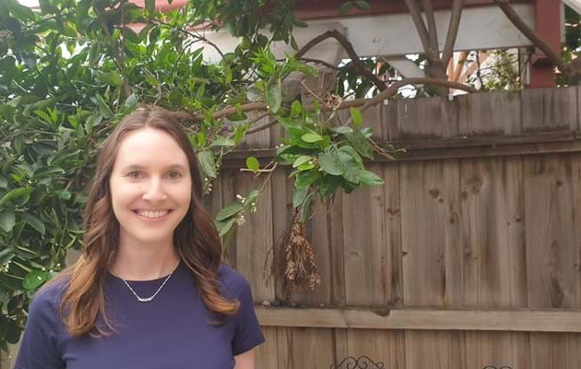
I think one of the things that helped me the most when I started learning was using the SaySomethinginWelsh app hand-in-hand with my Learn Welsh course. That's how I gained the confidence to speak Welsh, and I used to listen to the app while washing up!
- Josh Osborne, winner of the Learners' Medal at the 2022 Denbighshire Urdd Eisteddfod
I started learning Welsh in 2012 after hearing about the SaySomethingInWelsh (SSiW) app. I also love using the resources on the National Centre for Learning Welsh's website, learnwelsh.cymru, and have been following their online courses. This helps me learn new words and strengthens my pronunciation. I can now use what I learn in everyday conversations. I was able to use Welsh during my visit to the National Eisteddfod in Meifod in 2015.
- Liz Williams, a Welsh learner living in Australia
Notes:
The programme will include the following elements, we will go through them in more detail

Slide 14
Additional Resources
As a registered Dysgu Cymraeg learner, you’ll have access to hundreds of additional learning materials and short online courses – visit learnwelsh.cymru to browse all options and to keep up to date with the latest news and information about new learning opportunities.
Adnoddau Ychwanegol
Gan eich bod chi wedi cofrestru ar wefan Dysgu Cymraeg mae mynediad gyda chi at gannoedd o ddeunyddiau dysgu ychwanegol a chyrsiau byr ar-lein – ewch i dysgucymraeg.cymru i weld yr holl opsiynau a chael y newyddion a’r wybodaeth ddiweddaraf am gyfleoedd dysgu newydd.
Notes:
The programme will include the following elements, we will go through them in more detail

Slide 15
Additional Support: Contact us
You’re welcome to email us if you have any questions: saysomethinginwelsh@dysgucymraeg.cymru
Feedback
We welcome feedback at any time – just email saysomethinginwelsh@dysgucymraeg.cymru. We’ll also share a questionnaire with all learners to gather feedback about this resource. The questionnaire will be emailed to you, so please keep an eye out for it!
Cymorth Ychwanegol: Cysylltwch â ni
Mae croeso i chi anfon e-bost aton ni i ofyn os oes gennych unrhyw gwestiynau: saysomethinginwelsh@dysgucymraeg.cymru
Adborth
’Dyn ni’n croesawu adborth ar unrhyw adeg – ebostiwch saysomethinginwelsh@dysgucymraeg.cymru. Byddwn ni hefyd yn rhannu holiadur gyda'r holl ddysgwyr i gasglu eich adborth am yr adnodd hwn. Bydd yr holiadur yn cael ei e-bostio atoch chi, felly cadwch olwg amdano!
Notes:
The programme will include the following elements, we will go through them in more detail

Slide 16
Pob lwc, a mwynhewch! Good luck, and enjoy!
Notes:
The programme will include the following elements, we will go through them in more detail

